Slide 1
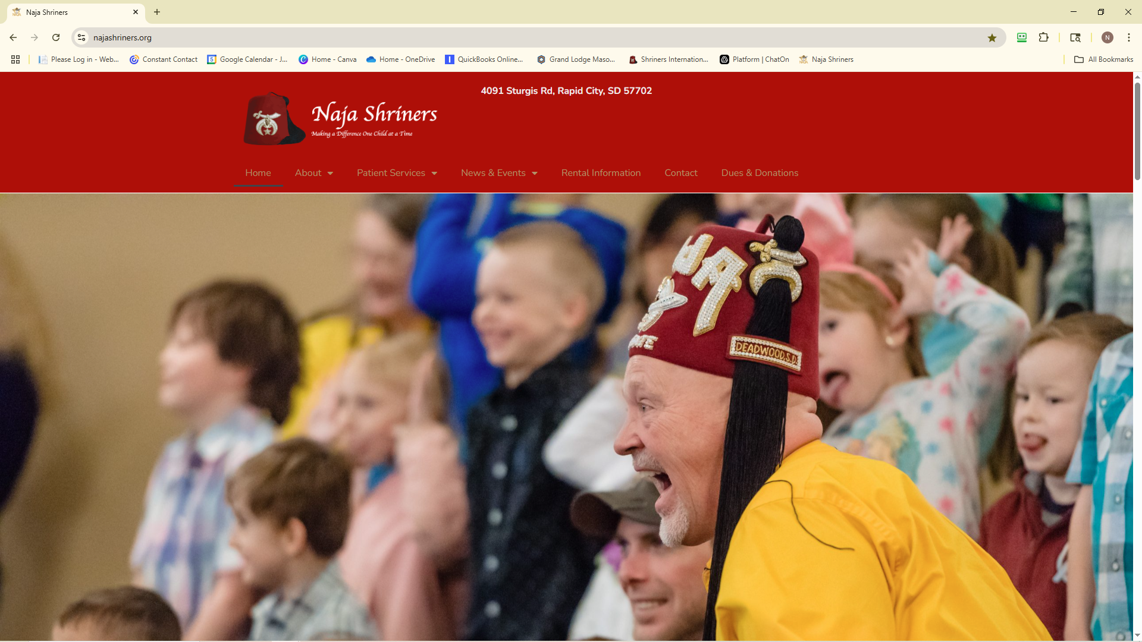
1. Log into
www.Najashriners.org
2. Click on Dues and Donations.

Slide 2
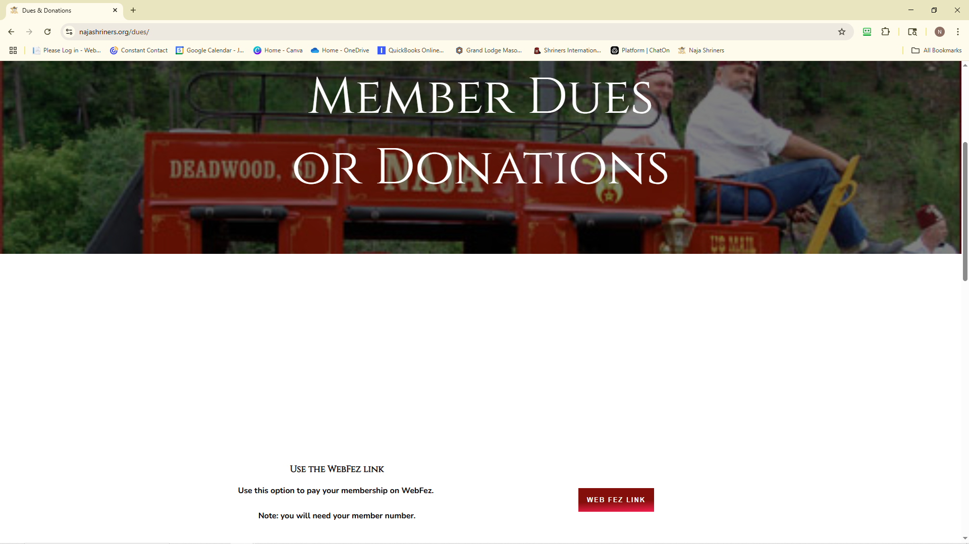
3. Select Web Fez Link

Slide 3
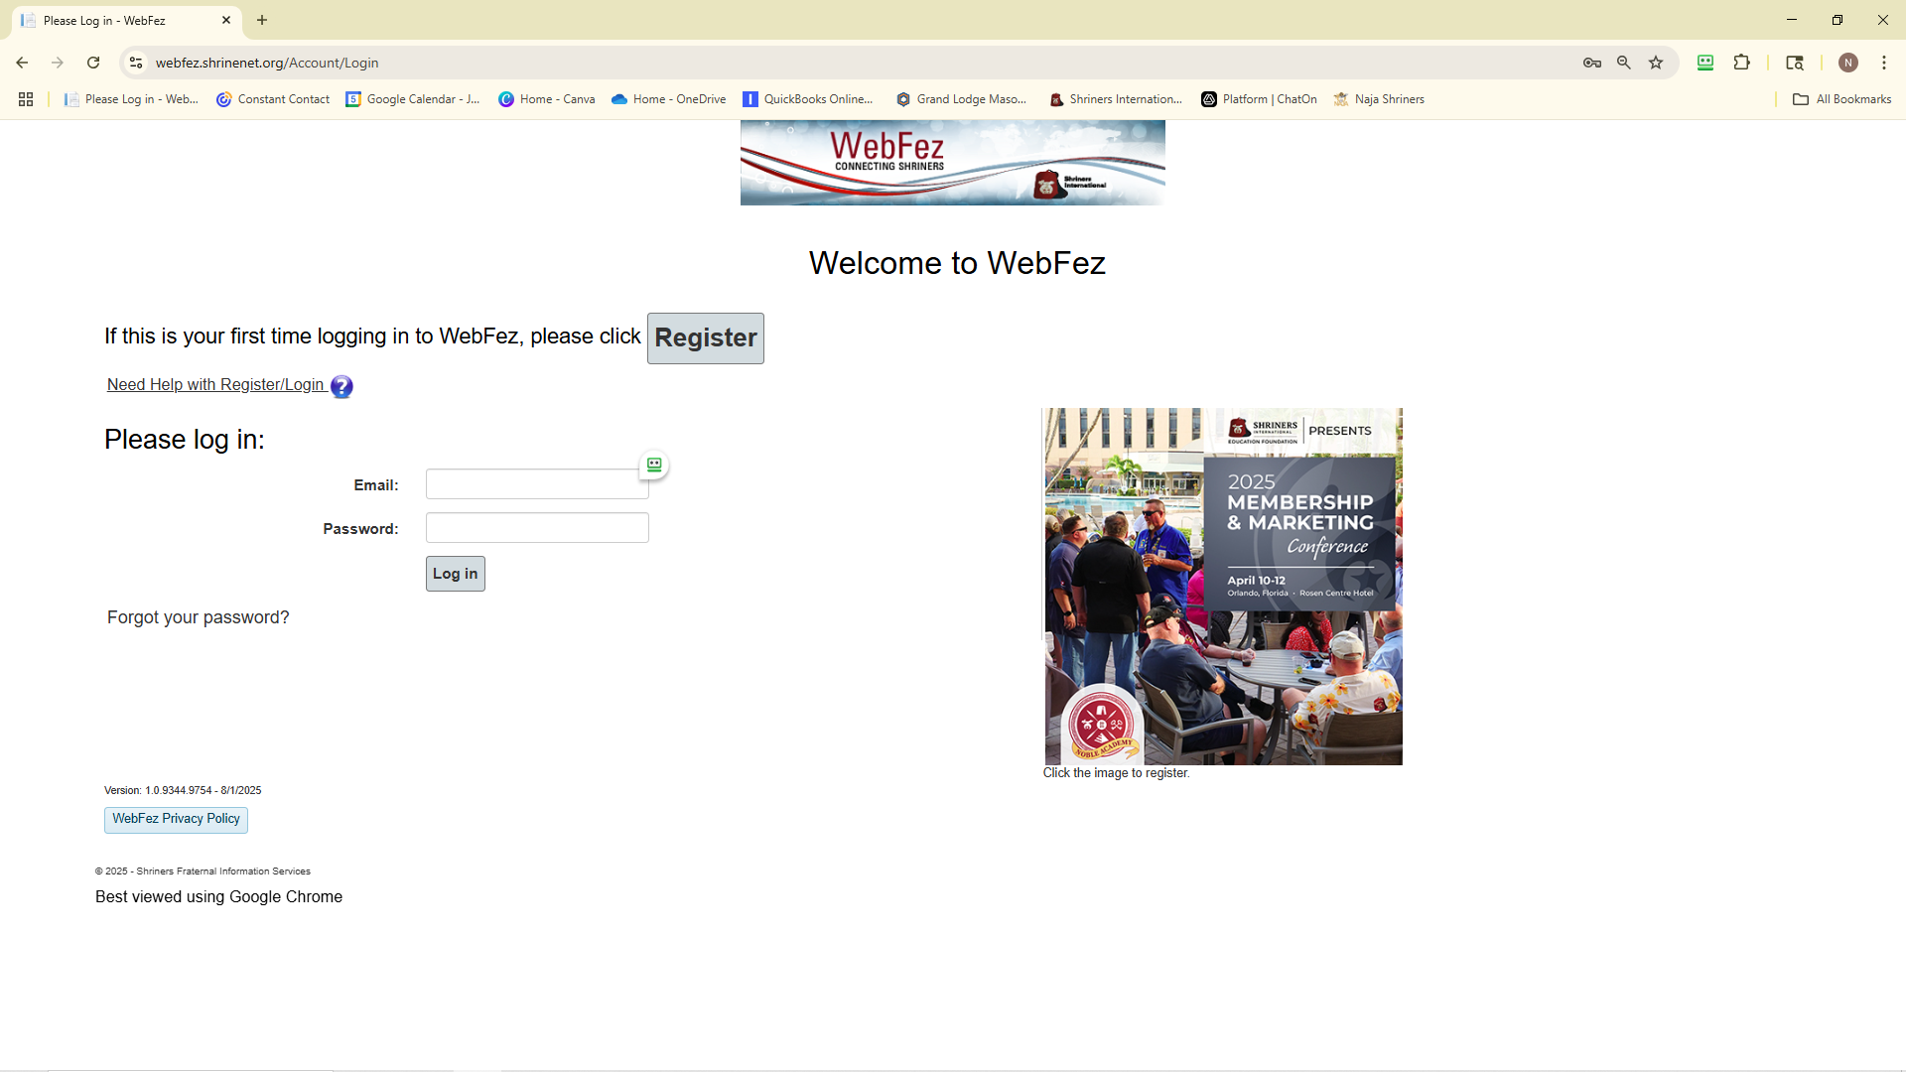
First time users Click this link if you don’t have your member number call the Shrine and we can get it for you.
If you have already
Registered click
Here and fill in the
Info.

Slide 4
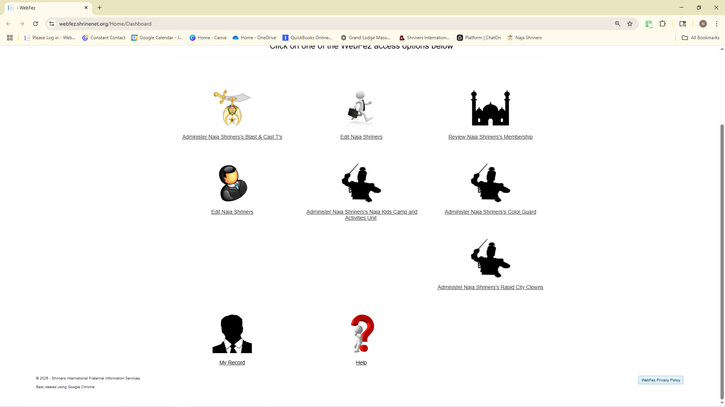
5. Select My Record

Slide 5
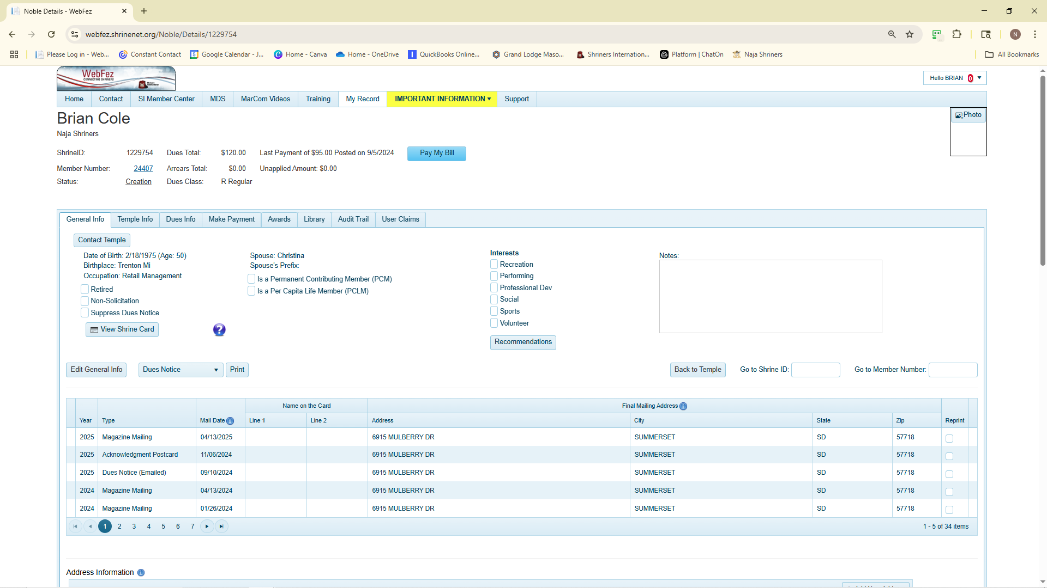
6. Click Pay My Bill

Slide 6
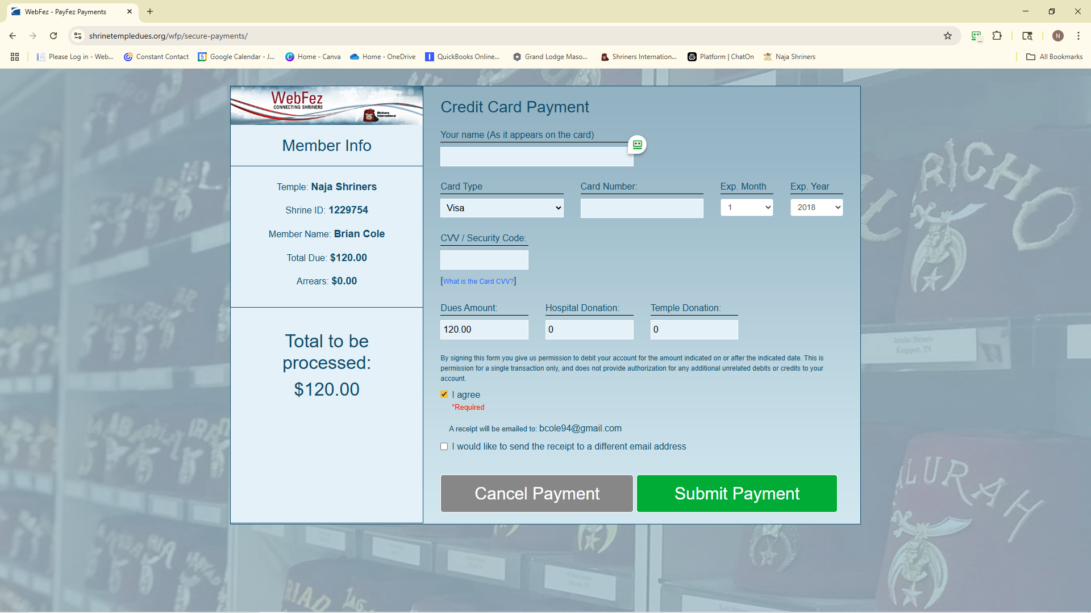
7. Fill in all Information

Slide 7
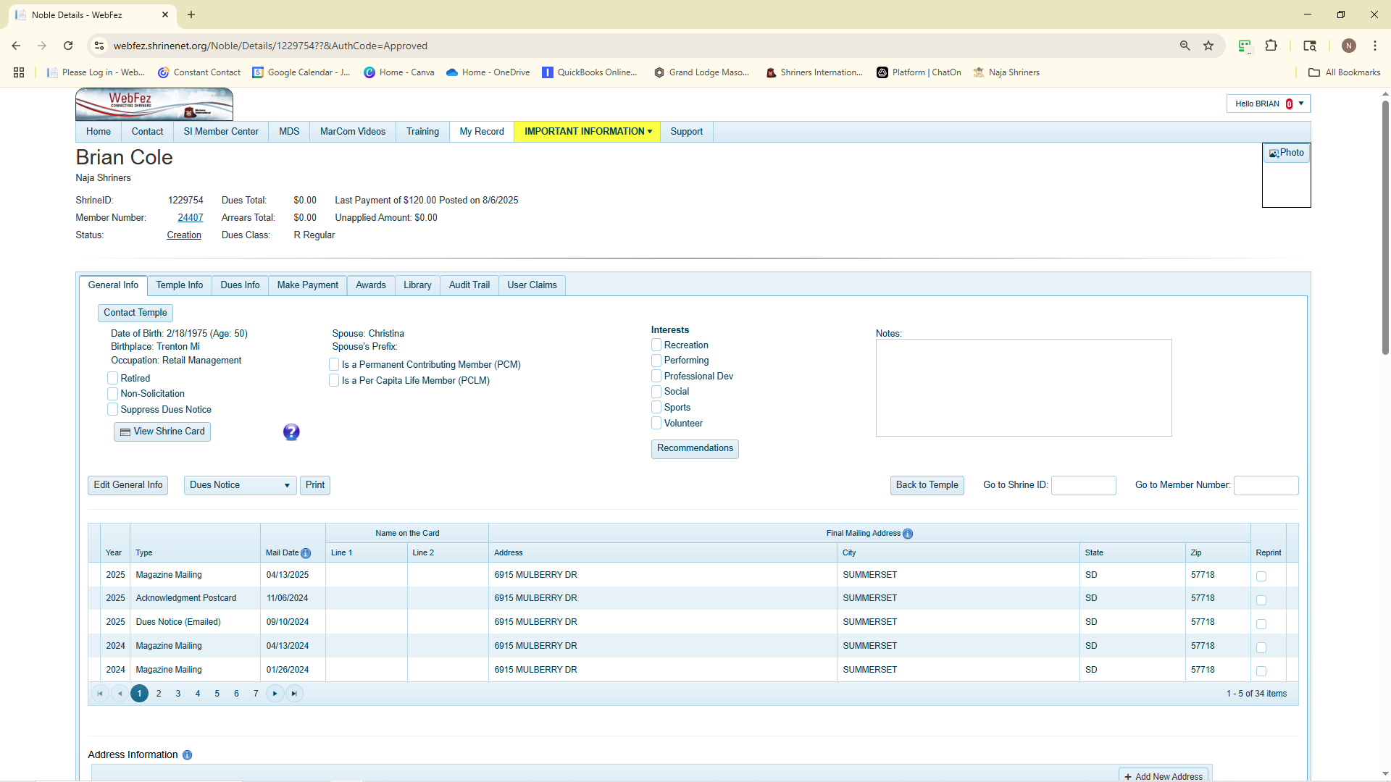
8. If done correct dues total will be $0 and the last payment will show the date.

